Slide 1

Securely Access Secrets within Azure Key Vault
Three approaches to retrieve secrets securely in Key Vault
Kuala Lumpur, 20 November 2017
Notes:
Good <morning> guys,
Thank you for joining this session. Today I am going to talk about how to retrieve your secrets securely within Azure Key Vault.
I will also explain about what the Key Vault is and then we will go through with each of the approaches.

Slide 2
Agenda
Secrets
A challenge you can count on.
Azure Key Vault
Discover Azure Key Vault and the problem while trying to access it.
1st Approach
Use client certificate authentication to access Key Vault from non-Azure environment.
2nd approach
Let Azure Resource Manager inject certificate into your VM(s) for authentication.
3rd approach
Managed Service Identity (MSI) automatically managed an identity in Azure AD for authentication.
Demo
Short demonstration of Client Certificate Authentication from local and also Managed Service Identity in Azure VM and Functions.
AWS offering & Pricing Comparison
Brief description of comparable AWS service and its pricing.
Notes:
So here is the agenda for today.
In addition with what I‘ve said earlier, we will also have a short demonstration on two of the three approaches.
So let‘s get started.

Slide 3

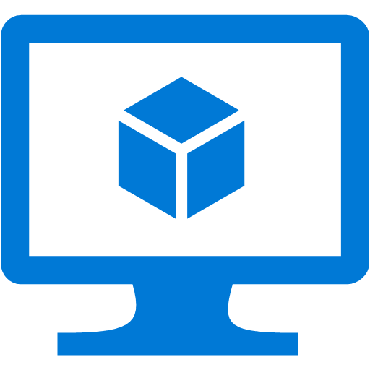

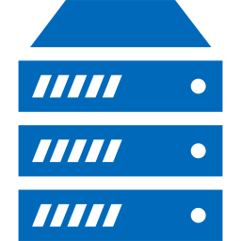
One challenge you can count on is…
Secrets
App Platforms
VMs
Connection Strings
Certificates
Client Secret
SSH keys
Passwords
Encryption keys
Containers
On-Prem Servers
Notes:
These days there are so many ways on how you can build your apps.
You can build your apps to be hosted in a web server inside a virtual machine or you can host it in a Platform as a Services like Azure App Service for example.
Or you can containerize your apps and maybe run it using some container orchestration.
Regardless of how you build your apps, You can always find a common challenge, which is Secrets! (click)
Things like connection strings to your database, passwords for your VMs, encryption keys, or anything which is not supposed to be acquired without proper permissions.

Slide 4
One reason is the bad guys
Secrets
App Platforms
VMs
Connection Strings
Connection Strings
Certificates
Client Secret
SSH keys
Passwords
Encryption keys
Containers
On-Prem Servers
Notes:
And why is it a challenge? (click)
Because of the bad guys!
They are all over the place, looking for access to your sensitive data.
But that is not the only reason.

Slide 5
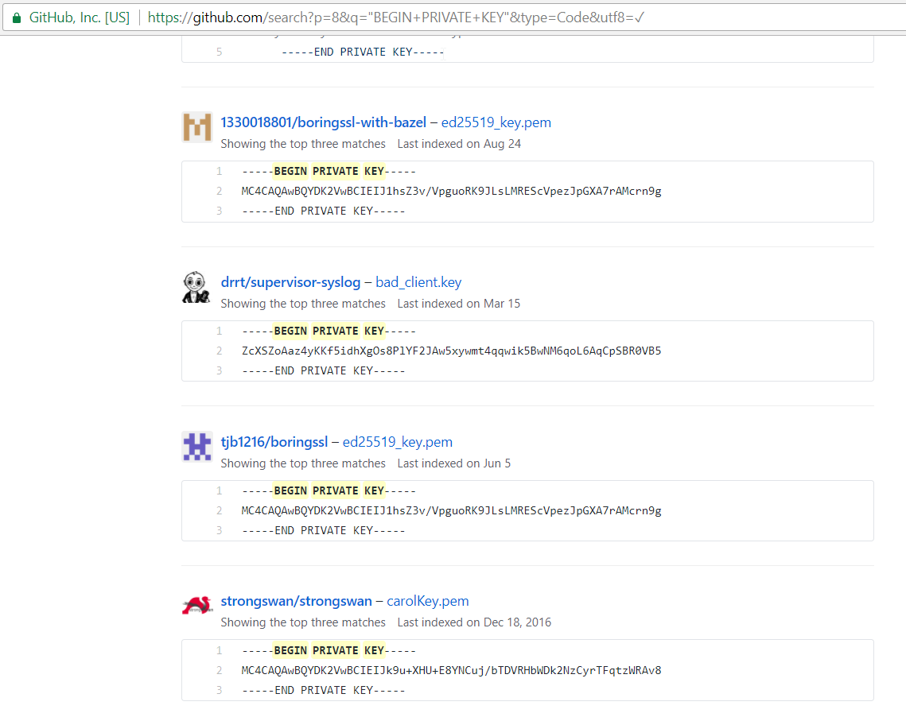
Another reason is negligence
Notes:
The other reason and probably the biggest reason is our own silly mistakes.
The developers or any engineers who works with these secrets are human after all, and make mistakes.
You’ve probably heard a numbers of data breaches are caused by human mistakes and these mistakes can cost companies a lot of money.
And what kind of silly mistakes? So just to take an example, I did a query on the GitHub with keyword “BEGIN PRIVATE KEY” and a lots of these keys which is supposed to be private shows up and with these, the attacker could potentially gain access to the system using these keys.
There are also things like connection strings or encryption keys being stored as plain text in the app configuration file.
Why does this happens? I would assume that things like this happens because of no proper tooling to help with this issue.

Slide 6

Azure Key Vault
Secret Store as a Service
Store and manage secrets.
Isolate cryptographic keys.
Backed by HSMs
Highly Available
6 total copies in second region within same geo.
Service fails over automatically within region, or to secondary region.
Integrated with other Azure services / SDKs
Allows automated flows of secrets from source to destination
Connection Strings
Encryption keys
Client Secrets
Passwords
Azure Key Vault
Notes:
So what tools that we can use to keep these secrets secured?
Pardon me for one marketing slide here ☺
So Azure Key Vault is what you should use in terms of securing secrets in Microsoft Azure.
It is basically a secret store as a service which you can also order a premium version that use a hardware security module.
Think of hardware security module as a black-box which you can use to encrypt or decrypt your data.
So yeah it is highly-available and can be integrated with other Azure Services especially Azure Resource Manager and has SDKs on multiple languages.

Slide 7
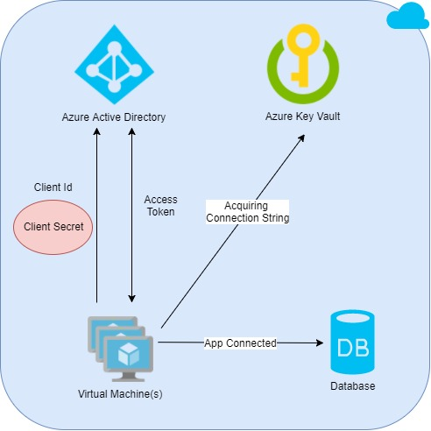

Accessing Key Vault
<?xml version="1.0" encoding="utf-8" ?>
<configuration>
<appSettings>
<add key="ClientId" value="clientid" />
<add key="ClientSecret" value="supersecret" />
</appSettings>
</configuration>
App
Deploying App
Developer
Notes:
If you have tried Key Vault already before, you probably know that you need to get an access token from Azure Active Directory to access the secrets stored in the Key Vault like shown in the picture. It uses the Oauth Client Credentials flow which is meant for machine-to-machine communication.
In this case, it use a client id and a client secret to authenticate and to get the access token. The client here is referring to an Azure Service Principal. So, Azure Service Principal is basically an identity for your application and you register it in the Azure Active Directory.
So that means you need a client id and client secret stored in your app in order to access the key vault, and most of the examples you’ve found on the internet just put these information as plain text in your app configuration file for example. Notice anything? Yeah, that means we are back to the same problem we have earlier which is this client secret here may be seen and used by the wrong persons!
So how do we solve this issue? Let’s take a look.

Slide 8
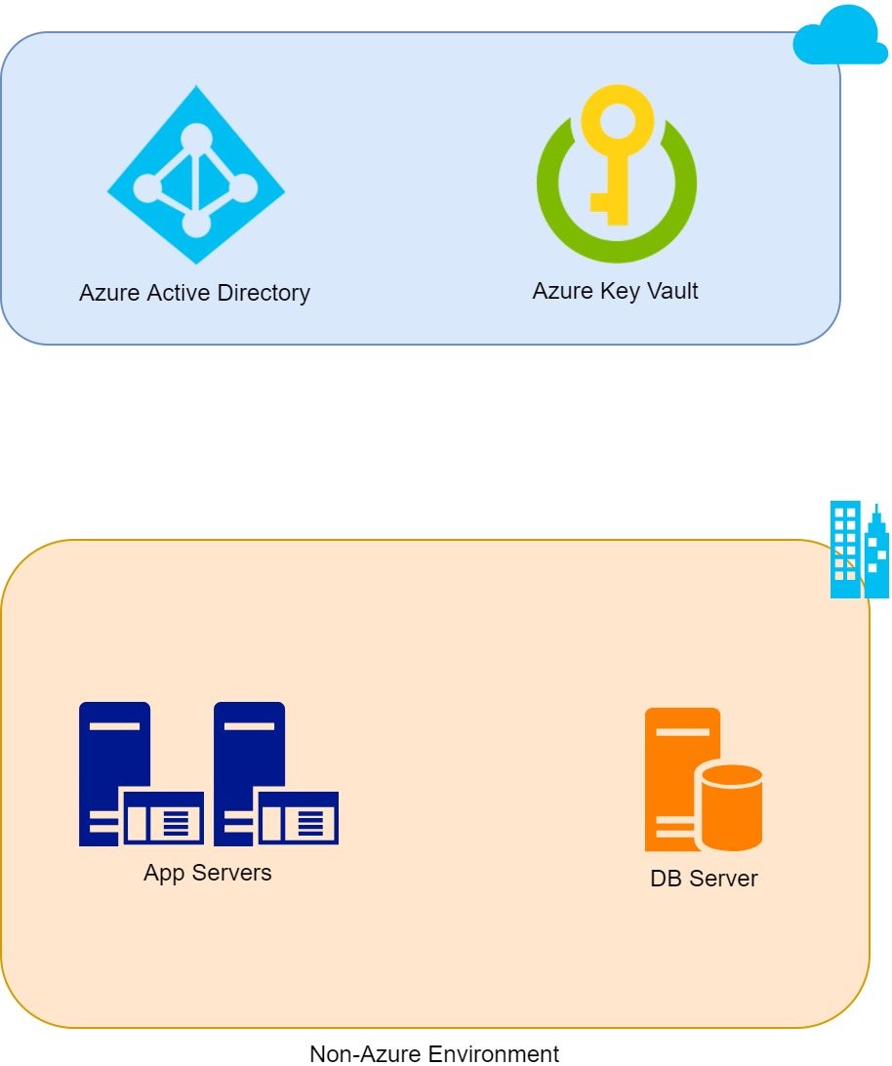
#1 - Client Certificate Authentication
Configure Access Policies for App XYZ Service Principal
Configure App XYZ Service Principal
with Certificate
Administrator
Acquire
Access Token
Acquire
Connection String
Deploy Certificate into App Servers
Certificate Store
App Connected
Deploying App XYZ
Developer
Notes:
On the first approach, we are using a certificate to authenticate and get access to the Key Vault.
On the right, we have a non-Azure environment with an App Servers that will host an app connected to a Db Server.
On the left, we have two roles, administrator and developer, please do not assume that this must be different persons, it could be one person as well.
So in order for the app to be able to authenticate we need to create a service principal, (click)
but this time we will configure it to use a certificate instead of password.
(click) After that we can configure its access to the key vault.
(click) And then the administrator need to deploy the certificate including private key into the app servers, now the exact location depends on the operating system and how the application is designed. And also the certificate must be protected with some permissions.
(click) And then the developer can deploy the app and use the certificate by its location.
(click) On the runtime, the app will authenticate to AAD and get the access token using this certificate.
I am assuming it works like this: so basically your app will encrypt some information, maybe the certificate or maybe others, with the private key the server have, and then because AAD has the public key and its asymmetric, it can decrypt the data successfully, and so because of that, they can be sure that we own the private key and they will give us the access token.
(click) (click) and then our app can get the secret from the key vault and connected to the database.
I hope my explanation is easy to understand ☺
So let’s move on to the second approach.

Slide 9
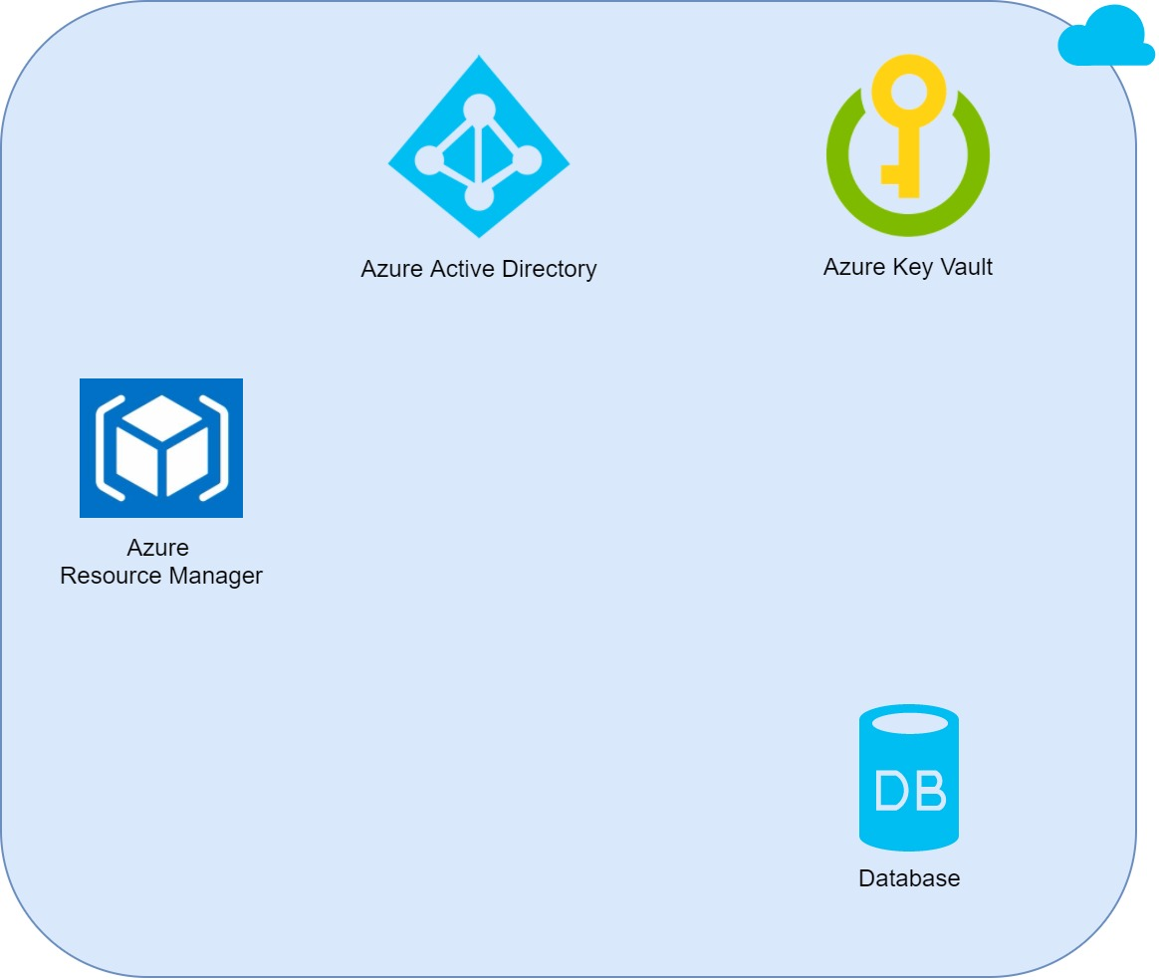
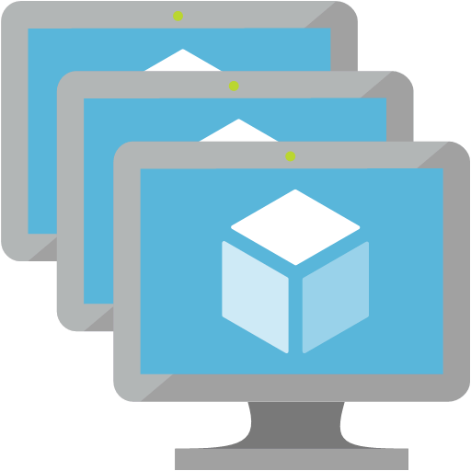
#2 – ARM VM Client Certificate Injection
Upload Certificate into Key Vault
Configure Access Policies for App XYZ Service Principal
Configure App XYZ Service Principal
with Certificate
Administrator
Acquire
Access Token
Acquire
Connection String
Deploying VM(s)
Injecting
Certificate
Deploying App XYZ
App Connected
Developer
Virtual Machine(s)
Notes:
On the second approach, we are using the same client certificate authentication like the first one, but because in this case our app infrastructure is hosted on Azure, we can use Azure Resource Manager to inject the certificate into the VM instead of doing it on our own.
To do this, after we configure the service principal, (click, click, click) we need to upload the certificate into the key vault so Azure can use it.
(click) and the developer can deploy the VM and refer to the certificate in the Key Vault, (click, click) and then Azure will inject the certificate into the VM automatically when it started.
As far as I know you must do this using an ARM template, creating the VM this way is not supported on the portal or cli or PowerShell. Think of ARM template as a way for you to define Azure Resources in a JSON object, I will try to show it later on the demo.
(Click), then the rest is pretty much the same as the first approach.

Slide 10
#3 – Azure Managed Service Identity
Configure Access Policies for VM(s) MSI
Administrator
Acquire
Access Token
Acquire
Connection String
Deploying VM(s)
with MSI
MSI VM Extension(s)
Deploying App XYZ
App Connected
Developer
Virtual Machine(s)
Notes:
The third approach use a new preview feature called Managed Service Identity. If you’ve been using IAM on AWS, it is pretty similar. So basically if you enable this feature, Azure will provide your resource an identity, so you don’t have to manage it on your own. The only thing that you need to do is only giving permissions. Currently it only supports VM, Web App, and Azure Functions.
You can enable MSI on existing resources using Azure Portal, and any other command line tools.
(click) (click) So let’s take a look on this picture. When the developer enable MSI on the VM, Azure will provide an MSI VM Extension to the VM, this extension is already loaded with credentials so you can use the extension to get the token.
(click) Because it automatically creates the service principal for this VM, the admin can grant this identity to Key Vault in this case, and the rest is pretty much the same (click click).

Slide 11
Managed Service Identity – How does it work?
Service
Principal
Azure Resource Manager
Azure AD Tenant
Service that Supports Azure AD Authentication
Azure VM
Your App
http://localhost:50342/oauth2/token
MSI VM Extension
Notes:
So how does this MSI works?
So here is the illustration on how the MSI works on a VM.
So here we got your app hosted on a VM, you want your app to be able to access this service for example Key Vault.
(click) And when you enable MSI, Azure Resource Manager, will automatically create a Service Principal on the AAD, and then add an extension to your VM with the credentials so now your VM has a new endpoint to get the access token like shown here.
So when the Service Principal is granted with permission, your app can just request to this endpoint and get an access token, and then you can use the token to connect with the services.
So in this case, you do not manage any credentials at all, just enable it, grant permissions, and you are all set!

Slide 12
Demo

Slide 13
AWS Offering & Pricing
EC2 Systems Manager Parameter Store
Parameter store provides a centralized store to manage your configuration data, whether plain-text data such as database strings or secrets such as passwords, encrypted through AWS KMS. Parameters can be easily referenced across AWS services such as Amazon ECS and AWS Lambda.
Through integration with AWS IAM, you can provide access control to specific parameters, letting you provide access to the data only to the users who need them and on which resources they can be used.
Pricing Comparison
 | Azure Key Vault | AWS Parameter Store w/ KMS
API Requests (operation) | $0.03 / 10K | $0.03 / 10K (Free 20K per month)
Customer Master Key (HSM-based for encrypting secrets) | N/A | $1.00 / Month / Key
Notes:
So for the last part, I just want to let you know, if you are using AWS instead of Azure, you can use EC2 Parameter Store to secure your secret. How it works is nearly the same as MSI, but in addition, you can use your own master key stored in HSM to encrypt the secrets.
The price per operation is same for both, but in AWS you get 20K free operation per month.
And you pay 1 dollar per month per key to encrypt your secret with custom master key in AWS.
That is all guys, I hope my explanation is clear and I hope it is useful.
Thank you!

Slide 14
Thank you for your attention!
Contact: Hendry Anwar | Arvato Systems | hendry.anwar@bertelsmann.de
IT.arvato.com

